Slide 2
Green Verifications

Slide 3
GOAL
90%

Slide 4
MVG

Slide 5
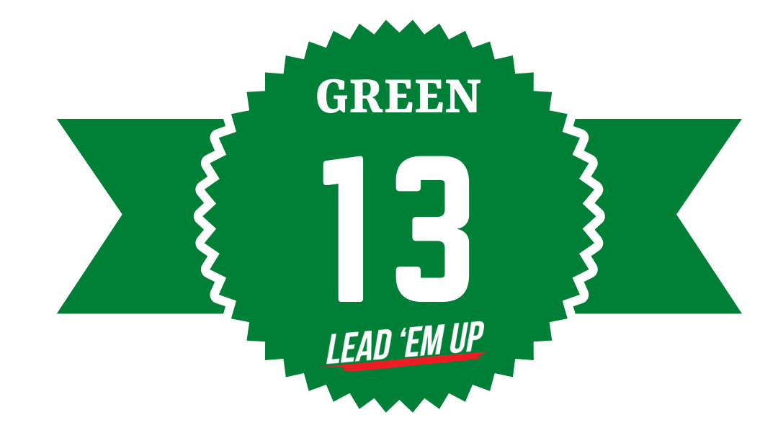

Slide 6
MAKE NOTE
Verified = live out standards at 90% > level
MVG = Most Valuable Green
Green 13 = National Leadership Award

