Slide 1
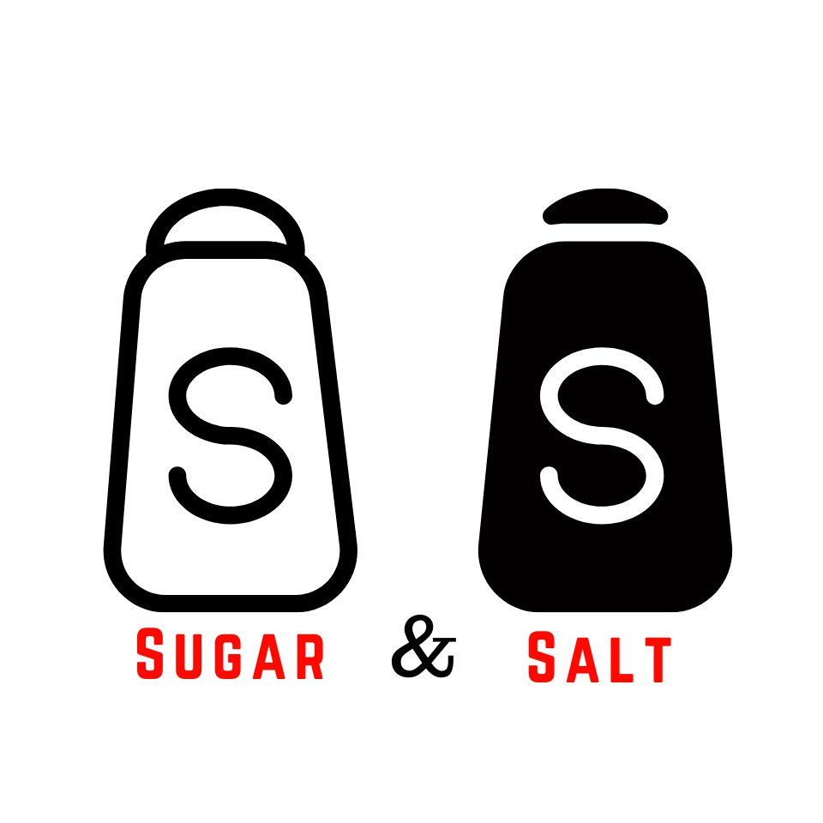


Slide 2

SUGAR
SALT
Gentleness,
Respect,
Kindness &
Love
Direct,
Keeps it Real
Says it like it is &
Straight-Forward

Slide 3
COMMUNICATION IS AN ART
Learn to balance Sugar & Salt

Slide 4
Guardrail #1
TIMING

Slide 5
FREQUENCY
OF
CONVERSATION
Guardrail #2

Slide 6
PROXIMITY
OF OTHERS
Guardrail #3

Slide 7
Guardrail #4
RELATIONSHIP

Slide 8
MAKE NOTE
  Identify which way you lean as a person - more salt or more sugar?
  If you lean salt - don't forget to be "salty" and "say it like it is" on all the good things you see around you
  When in doubt, lean sugar, it gives you a second chance.

