Slide 1



Slide 2
one’s performance level in following
the leader
FOLLOWERSHIP

Slide 3
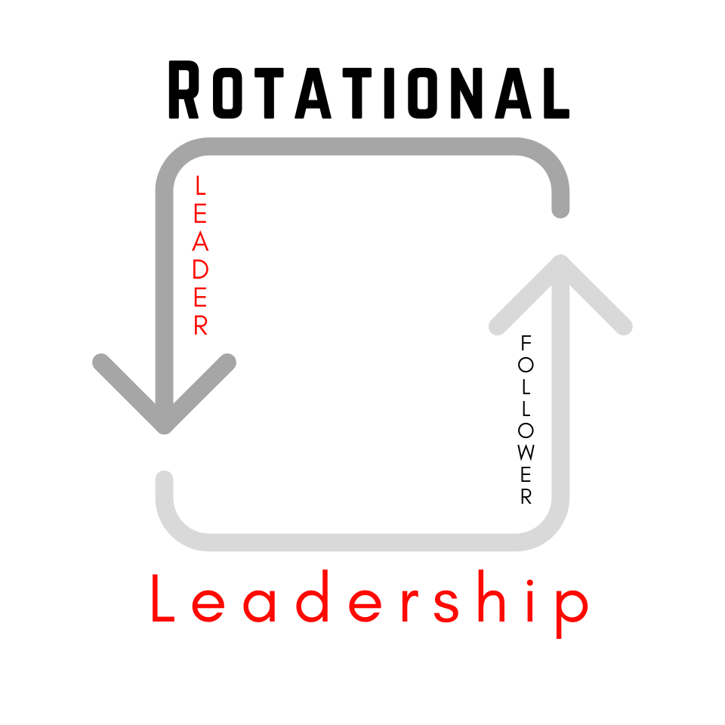

Slide 4
LEADERSHIP IS ALWAYS ROTATING
everyone plays a part

Slide 5
RED
Challenging to lead

Slide 6
GRAYS
easy to lead

Slide 7
GREEN
ENJOYABLE to lead

Slide 8
MAKE NOTE
Green Followers do the following 4-things:
Thank the Leader
Give Energy to the Leader
Show a Hunger for More Learning
Demonstrate Growth

