Slide 1
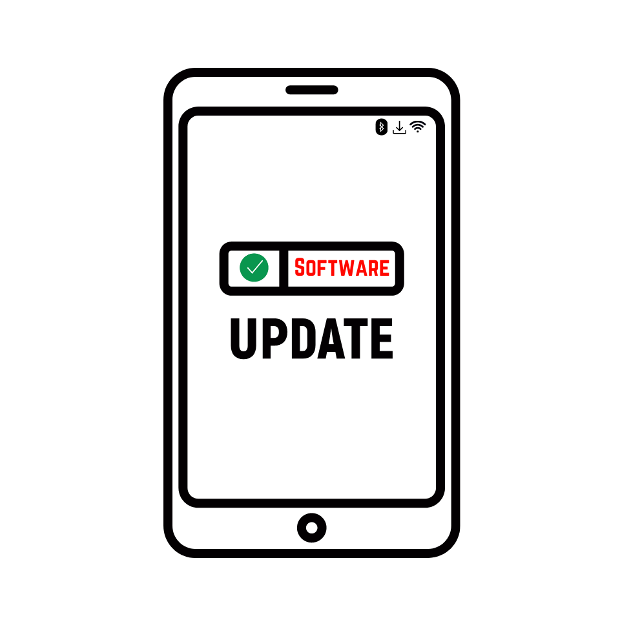


Slide 2
WE NEED UPDATES

Slide 3
WHY THE RISE IN THE NUMBER OF IOS UPDATES?

Slide 4
1.
the rising complexities of the devices

Slide 5
change and activity in the marketplace
2.

Slide 6
3.
delivering your best is paramount

Slide 7
IOS
Individual Operating System

Slide 8
SOFTWARE UPDATE
removal of bugs and addition of updates

Slide 9
error, flaw or fault in one's IOS
BUGS

Slide 10
NOTIFICATIONS
a prompting or reminder suggesting an update

Slide 11
two things incapable of coexisting
INCOMPATIBILITY

Slide 12
HARDWARE
physical exterior one presents to others

Slide 13
inner-workings of who you are
SOFTWARE

Slide 14
3 MAIN EVALUATION AREAS
  What people see
  What you see
  What others see

Slide 15
2 bug removals &
2 updates
2 & 2

Slide 16
  Overlap?
  Potential Harm?
  Improve Performance?
FOCUS GUIDE

Slide 17
MAKE NOTE
  Self-awareness is a critical skill-set all leaders must possess
  Similar to software updates on our phones, we need “updates” to our IOS (Individual Operating System) as well
  We need to constantly work to remove bugs and update our IOS

