Slide 1
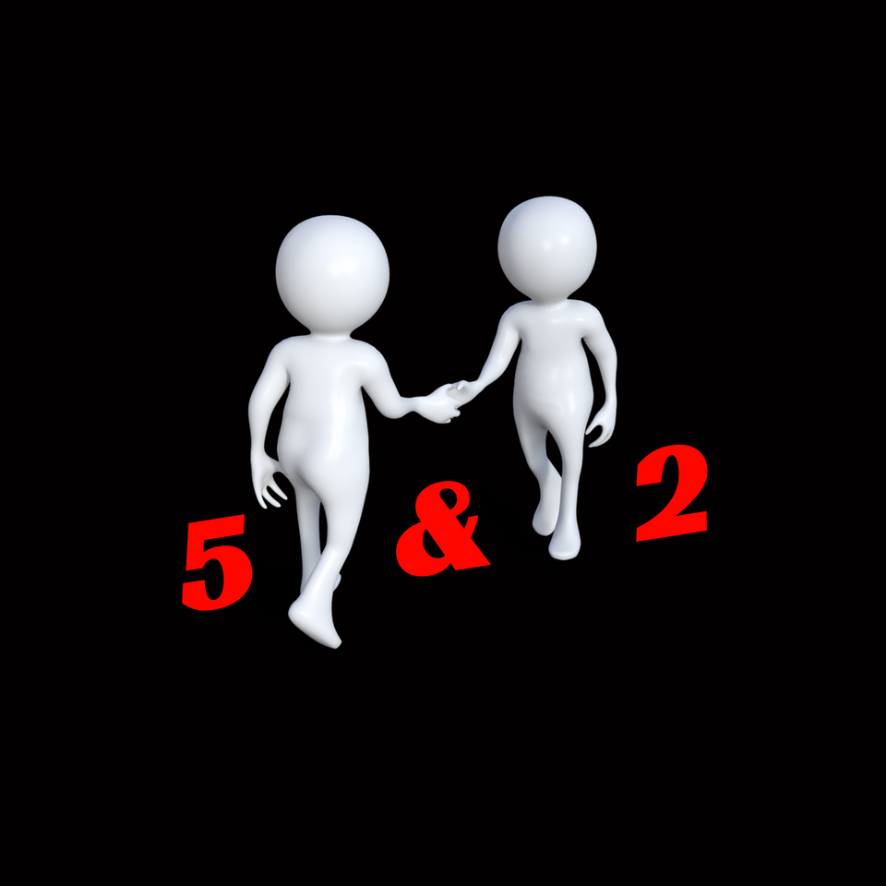


Slide 2
MAKE A HEALTHY AND MEMORABLE FIRST IMPRESSION

Slide 3

5 FINGERS

Slide 4

2 EYES

Slide 5

FIRM
FRIENDLY

Slide 6
Avoid
  Shake & Run
  The Guilty
  The 3 Fingers
  The Sleep Deprived

Slide 7
MAKE NOTE
  The essentials: 5 fingers and 2 eyes
  Find the perfect balance between firm & friendly
  A proper handshake helps individuals make a healthy and memorable first impression with others.

