Slide 2
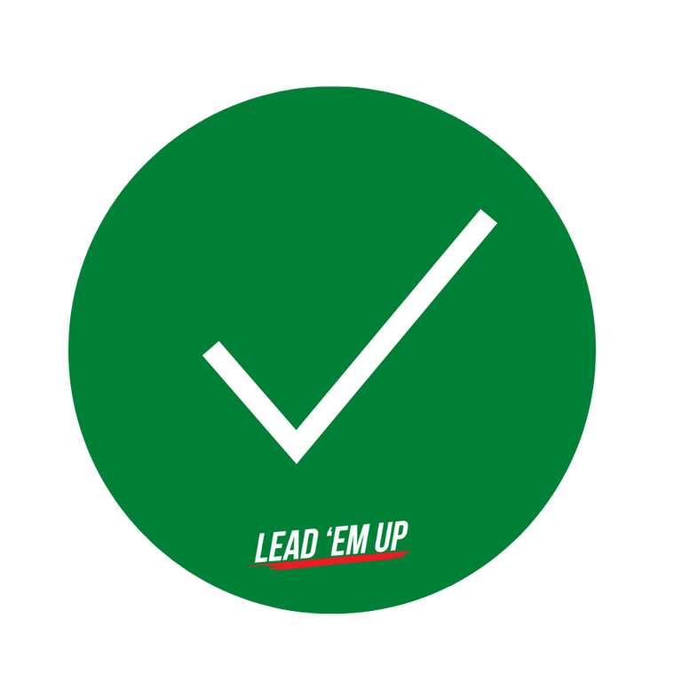
Green Verifications

Slide 3
GOAL
90%

Slide 4
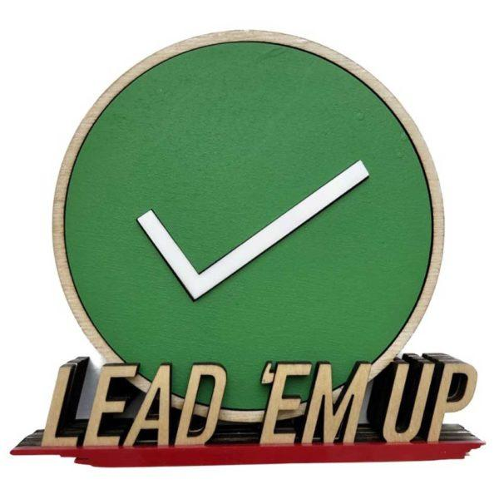
MOST
VALUABLE
GREEN

Slide 5
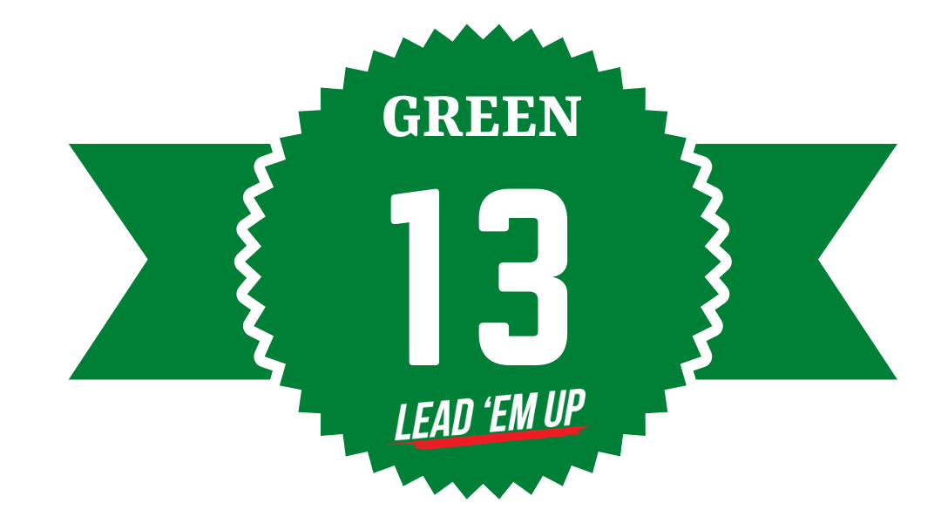

Slide 6
MAKE NOTE
Verified = live out standards at 90% > level. Voting is done by teammates and approved by the coaches
MVG = Most Valuable Green selected by the team at the end of the year
Green 13 = National Leadership Award nominated by your coaches and selected by the Lead ‘Em Up team

