Slide 1



Slide 2

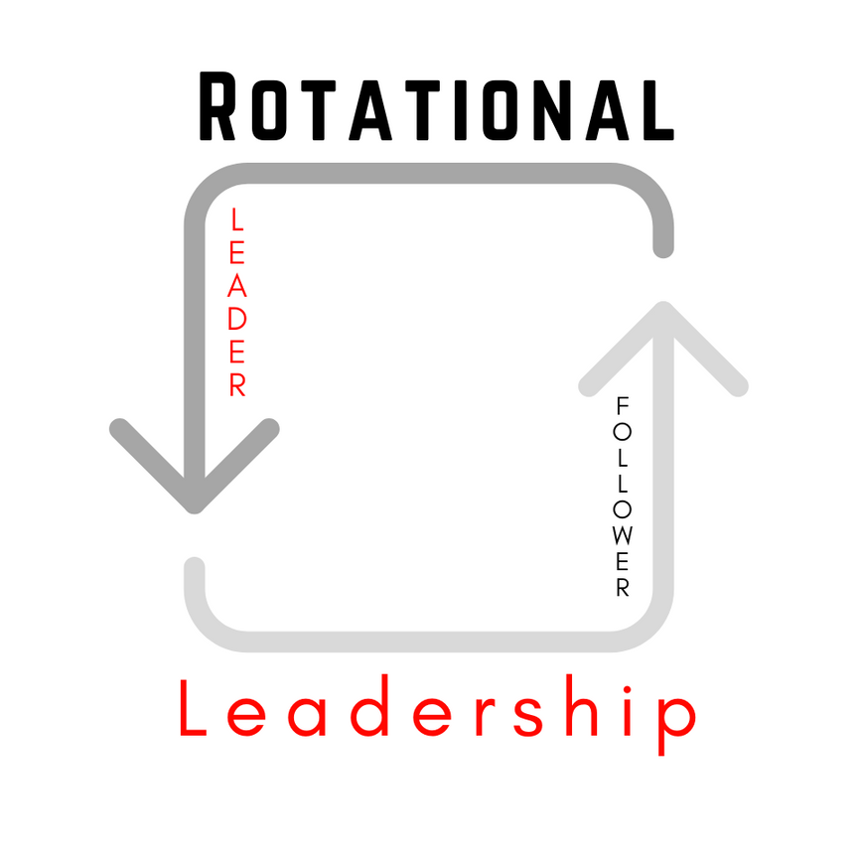

Slide 3
any form of positive leadership being given
PASS

Slide 4
THANK "THE COURAGE"
not the content

Slide 5
MOMENT OF TRUTH
What will the response be?

Slide 6
TO PUT COURAGE INTO
ENCOURAGE

Slide 7
To remove courage from
DISCOURAGE

Slide 8
MAKE NOTE
  Thank the passer every time
  Thank the courage, not the content
  When we Thank The Passer, we put courage into the passer

