Slide 1



Slide 2
one’s performance level in following the leader
FOLLOWERSHIP

Slide 3
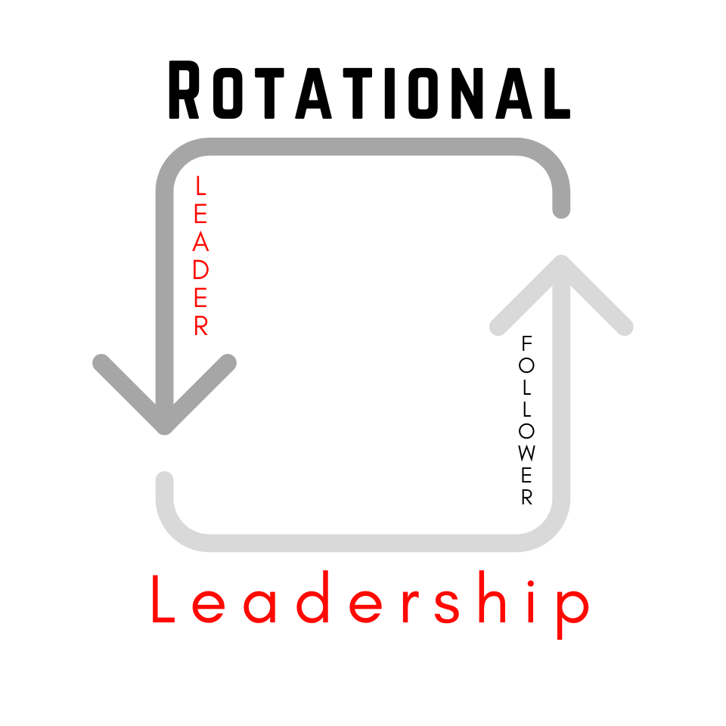

Slide 4
LEADERSHIP IS ALWAYS ROTATING
everyone plays a part

Slide 5
REDS
Challenging to lead

Slide 6
GRAYS
easy to lead

Slide 7
GREENS
ENJOYABLE to lead

Slide 8
MAKE NOTE
  Green Followers do the following 4-things:
  Thank the Leader
  Give Energy to the Leader
  Show a Hunger for More Learning
  Demonstrate Growth

