Slide 1



Slide 2
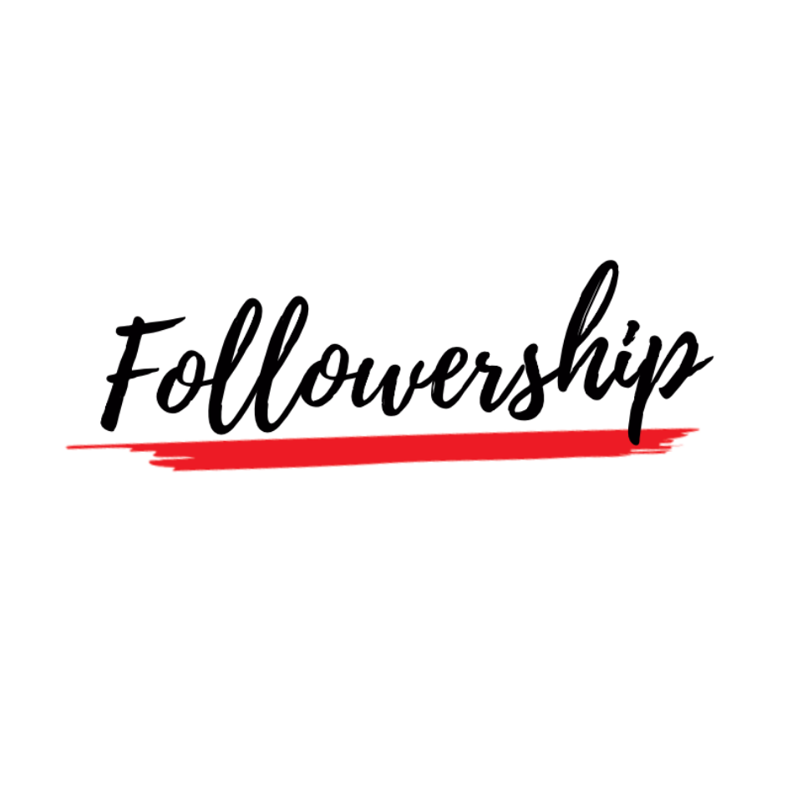
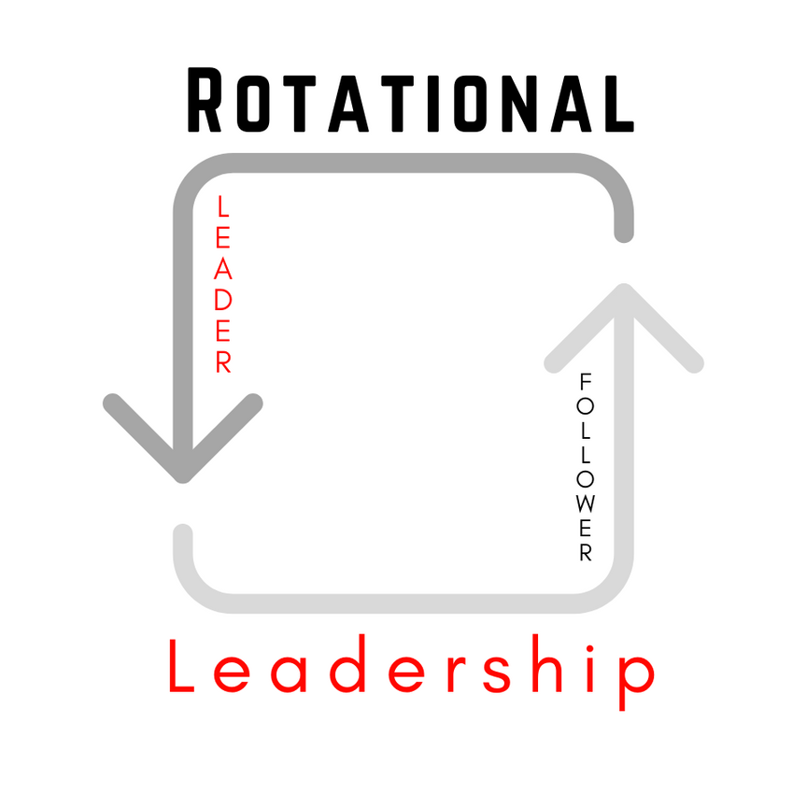

Slide 3
WHY DO PEOPLE RACE TO BE THE 1ST LIKE ON SOCIAL MEDIA?

Slide 4
verbal support; physical acknowledgement
"LIKE"

Slide 5
1ST LIKE IS THE WINNER

Slide 6
GOAL
Make leadership go viral

Slide 7
MAKE NOTE
  A "like" is verbal support, a physical acknowledgment
  Help classmates' leadership go viral
  First Like creates an environment that produces greater leadership with more impact.

